Slide 1
New Pricing Model
What is the right amount and why?

Slide 2
Problem Statement
Can Big Mountain Resort use the data from 330 US ski resorts to create a more informed pricing strategy for tickets and to guide future changes to reduce costs and support a higher ticket price for next season?

Slide 3
Problem Identification
Our current pricing strategy is to charge a premium over the average price.
We might be charging less than we could be given our current facilities.
We have no idea what facilities visitors find the most valuable.
We don’t know how best to update our facilities to support a higher ticket price.
We will create a pricing model based on the data from resorts all over the United States.
We will have a better idea of what ticket price we currently have support for.
Future improvements will be guided by important features inferred from the model.

Slide 4
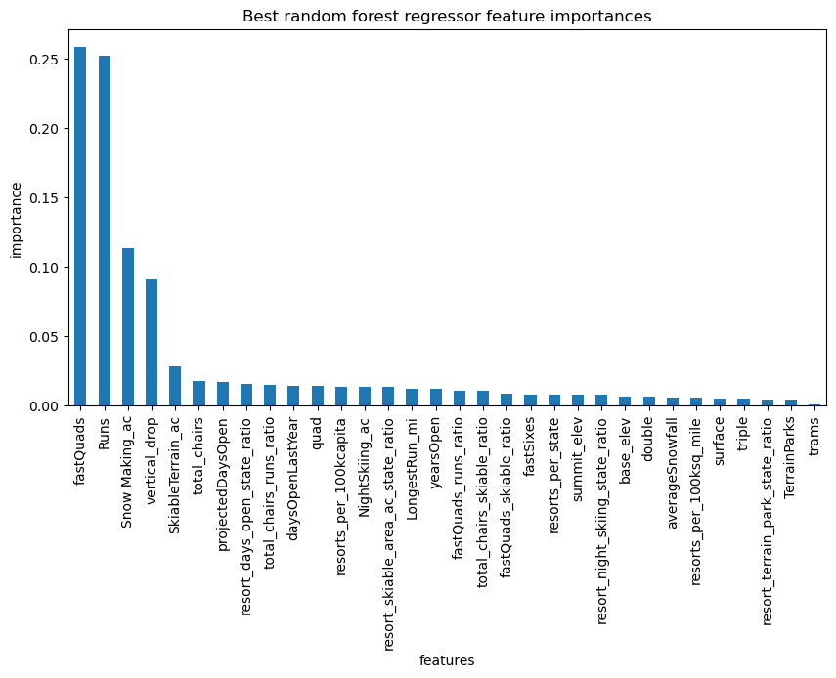
Suggestion and Key Findings
We can confidently charge more given our current position. A Price of $95.87/ticket is what the model expects and this more than covers the increased operating costs of our new chair lift.
Important features were found to be fast quads, number of runs, area covered by snow making machines, and vertical drop.

Slide 5
Modeling Results
Four potential scenarios were offered.
Close between 1 and 10 runs.
Increase vertical drop by adding a new run that ends at a point 150 ft lower. No new snowmaking.
Same as previous but with snowmaking.
Increase longest run by 0.2 miles requiring 4 more acres of snowmaking.
Of these scenarios, the second option provides support for an increase in ticket price of almost two dollars.
The first option while supporting a slightly lower ticket price would significantly lower operating costs.

Slide 6
Conclusion
We started with a pricing strategy that left us flying blind with regard to what’s important at our resort and how best to serve our customers.
We used the data available to create a new strategy that incorporates knowledge of our facilities and our position in the market.
We have a plan moving forward that is guided by our new model.
We can improve our model by obtaining more data.

